Slide 1
BUSQOM 1080 Model/Variable Selection Pitfalls
Fall 2020
Lecture 14
Professor: Michael Hamilton

Slide 2
Lecture Summary
Today: Pitfalls of Multiple Regression
P-Hacking I: The effect of sample size on significance [10 Mins]
P-Hacking II: Find significance in noise with model selection [10 Mins]
Polynomial Regression and Overfitting [10 Mins]

Slide 3
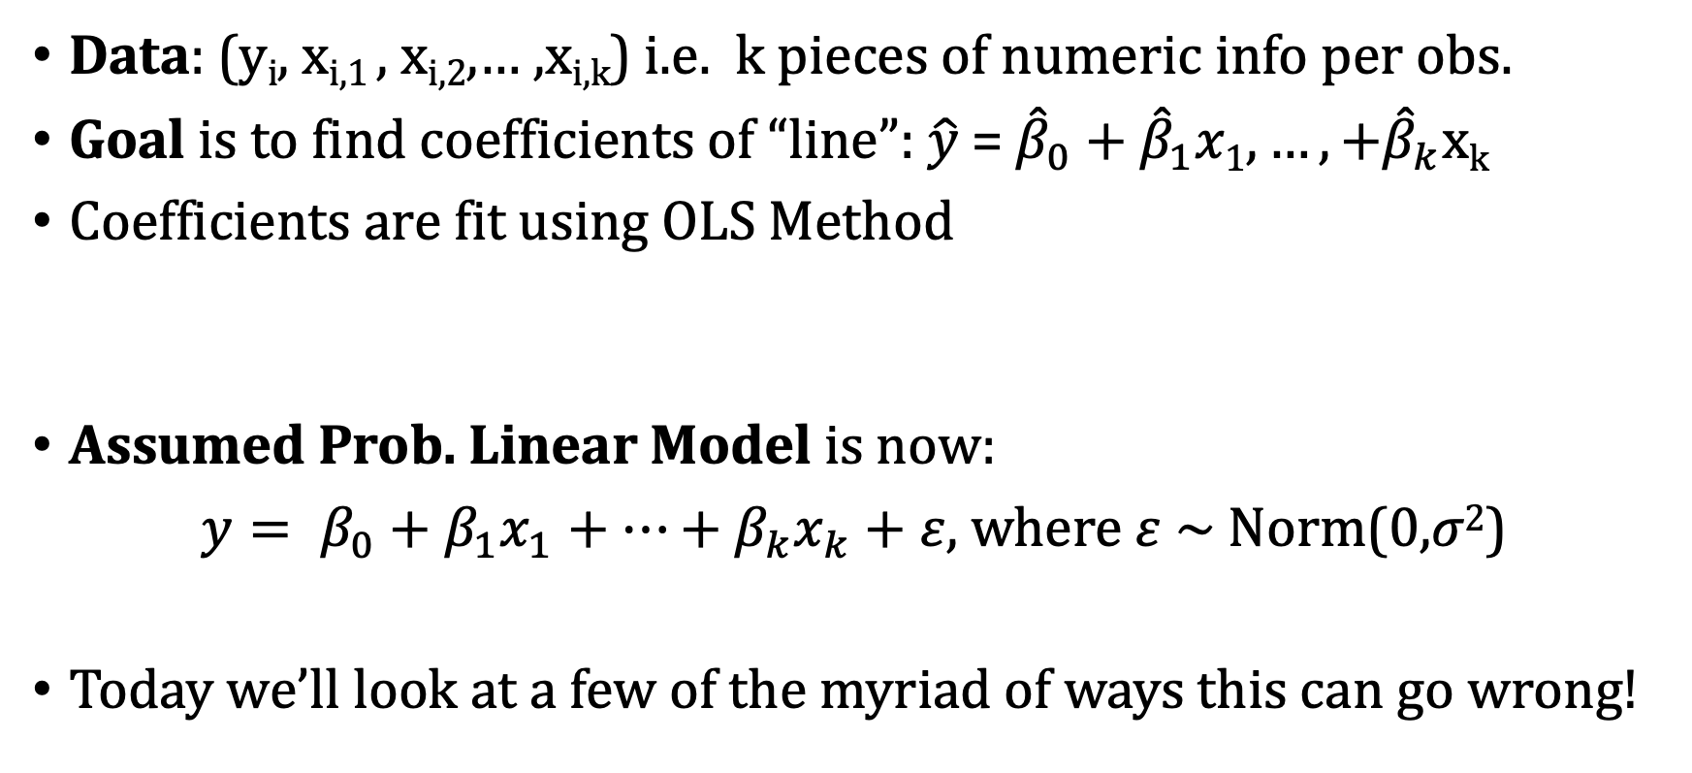
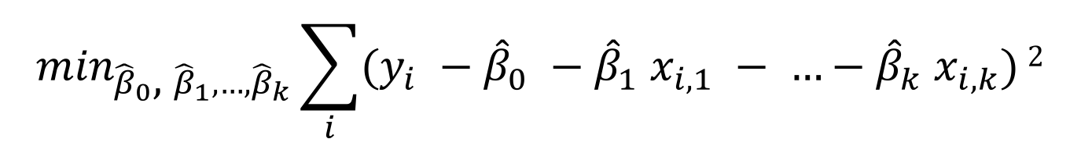
Review: Multiple Linear Regression
Data: (y_{i}, x_{i,1} , x_{i,2},… ,x_{i,k}) i.e. k pieces of numeric info per obs.
Goal is to find coefficients of “line”: $\hat{y}$ = ${\hat{β}}_{0}\text{ +} {\hat{β}}_{1}x1, …,+{\hat{β}}_{k}$x_{k}
Coefficients are fit using OLS Method
Assumed Prob. Linear Model is now:
$y= β_{0}+β_{1}x_{1}+…+β_{k}x_{k}+ε,$ where $ε$ ~ Norm(0,$σ2$)
Today we’ll look at a few of the myriad of ways this can go wrong!
$\min_{{\hat{β}}_{0}\text{, }{\hat{β}}_{1}, …,{\hat{β}}_{k}}\sum_{i}{(y_{i} −{\hat{β}}_{0} −{\hat{β}}_{1} x_{i,1} − …−{\hat{β}}_{k} x_{i,k})}$²

Slide 4
P-hacking for Multiple Linear Regression
p-hacking: is the misuse of data analysis to find patterns in data that can be presented as statistically significant (also known as data dredging, data fishing, etc.)
In multiple regression, one common way to measure if the regression captures a significant linear relationship is by examining the p-value of the F Test.
Two common ways of hacking this value:
Looking at data with extremely large sample size
Almost everything has some correlation, but it can be extremely small and hugely outweighed by the noise making it useless/uninteresting
Searching over many many models for one that is significant
p values measure how likely it would be to observe such a model under the null hypothesis, if you look at enough models you’re likely to find outlier models

Slide 5
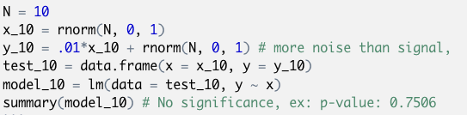
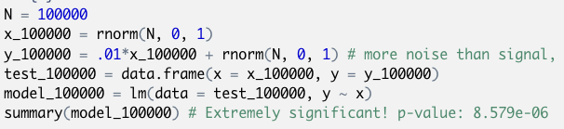
P-values and Sample Size
As the sample size of the data increases, so too does the confidence that the F test can pronounce that there is linear correlation, even if that correlation is hugely outweighed by the noise.
Experiment:
Suppose Y = .01*X + Norm(0,1), error outweighs the correlation and is insignif. for small sample size. Still there is a relationship, even if pointless and it will be found for large enough sample size.

Slide 6
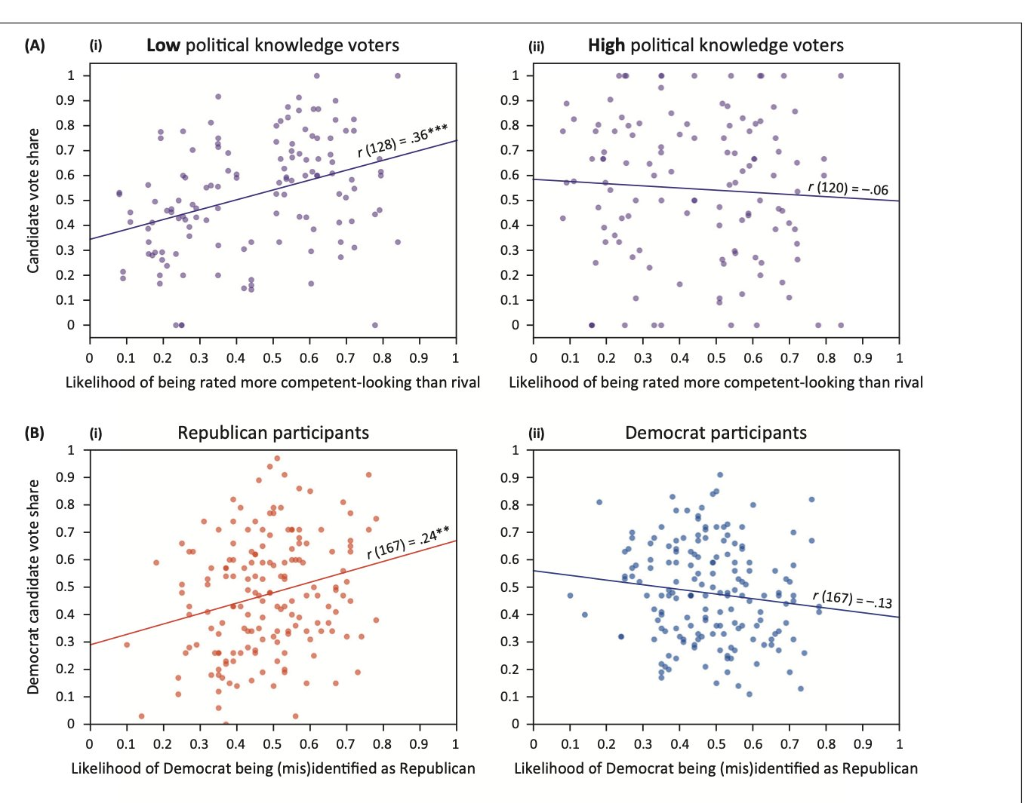
P-values and Sample Size
In practice this can lead to “strong evidence” for extremely weak, borderline line nonexistent correlation. Often used to justify bizarre claims
Example:
Notes:
There are a huge number of points, enable statistically significant correlation but the regressions don’t pass the eye test.
These are lines fitted to data which is primarily noise!
Hard to draw any kind of sensible conclusion from this
This is a case where R² is helpful

Slide 7
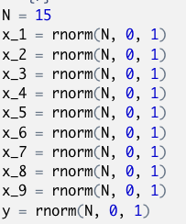
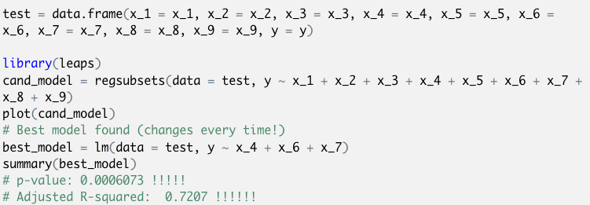
P-values and Choosing Models
Another way to hack the p-value is to consider many models (either explicitly or implicitly). A p-value is a measure of how unlikely a model would be under the null hypothesis, if you examine many models and their p-values you’re likely to find an unlikely one!
To mitigate this, experimental design and features should be decided before the regression is run!
This is especially a problem for best subset regression since that considers a ton of models! Can find “great” models on noise this way
Experiment:

Slide 8
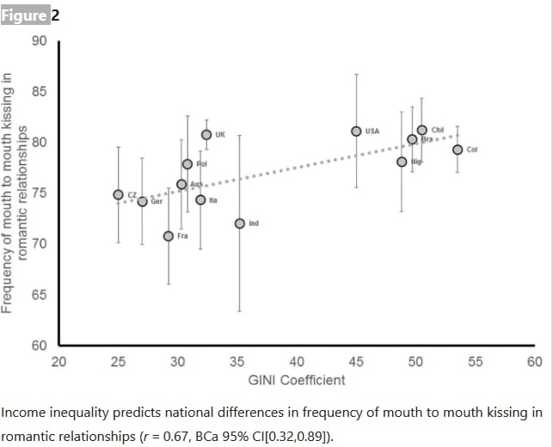
P-values and Choosing Models
In practice this can lead to some very weird associations between seemingly unrelated things!
Pay close attention to the R² when you hear there is a signif. association.
Example:
Notes:
The data here is quite small, only a handful of countries much like our experiment in the last slide!
You can imagine playing with different measures of promiscuity and economic well being until you hit on something ”significant”.

Slide 9
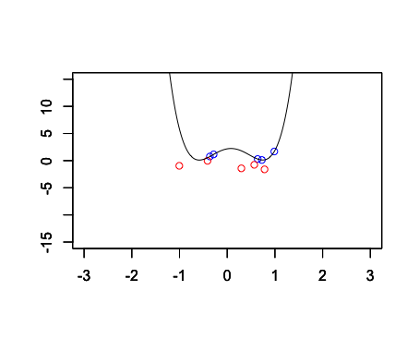
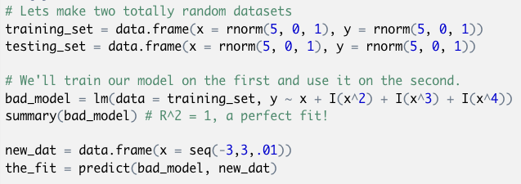
Interpolating Data for Inference/Prediction
Math Fact: Higher order polynomial terms will improve the R² of your prediction. With enough polynomial terms you can always perfectly fit your data!
However just because you fit your data doesn’t mean your model is useful or interesting! You can overfit, destroying any useful.
Experiment:

Slide 10
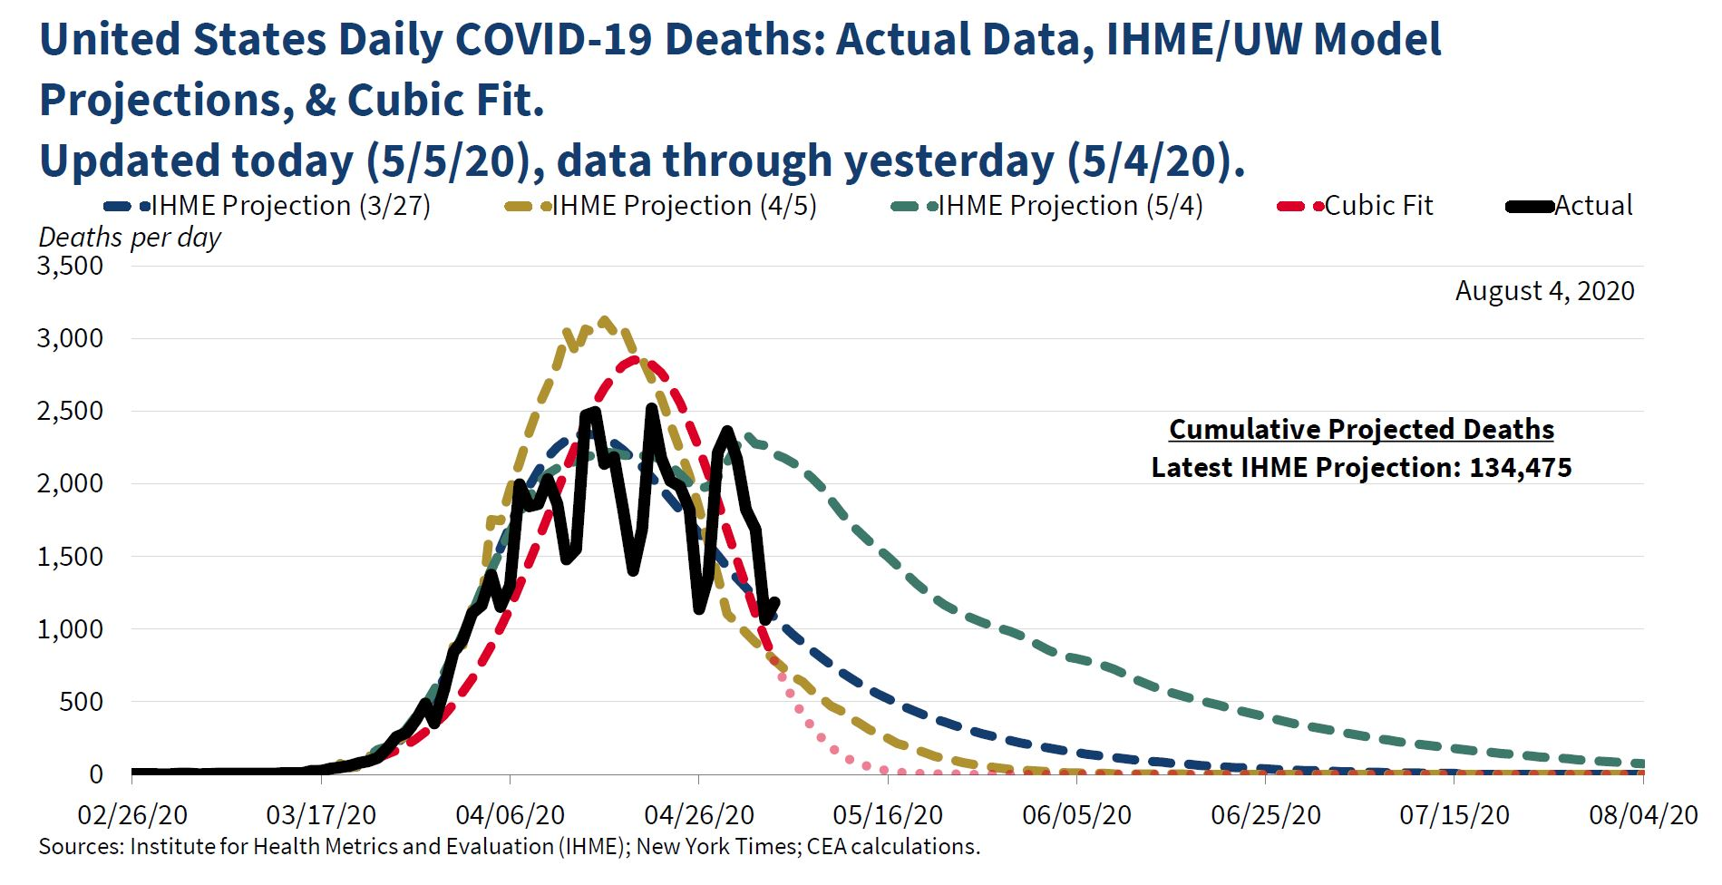
Interpolating Data for Inference/Prediction
In practice this can be extremely misleading. It’s often used to exaggerate or lie about trends in the data
Example: The counsel of economic advisors (CEA) put out this cubic regression model fitting COVID deaths, and predicting (pink) the pandemic would end by April
Notes:
A cubic model would then go off to negative infinity, making it a bizarre model for prediction.
To cover for this fact they literally drew on a trend line in pink that goes off to zero for the future (see red square)
A 200 thousand more Americans have since died.
The authors of this model continued to defend it until they resigned from the counsel. Otherwise, no consequences

